Slide 1
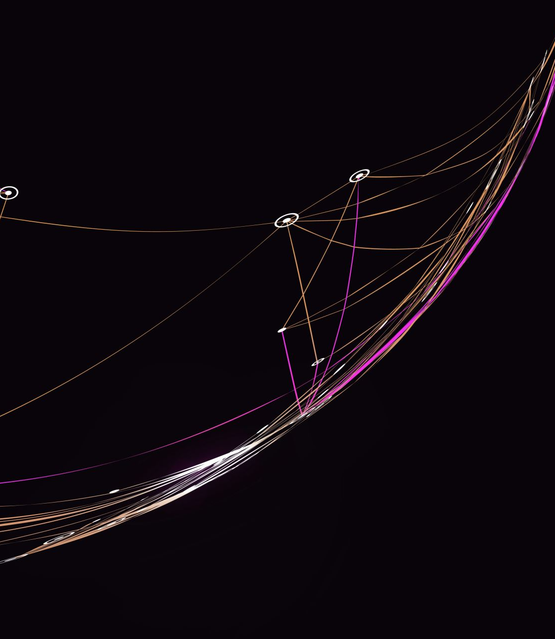
Redefining Data Retrieval: Query Optimization in Big Data Environment (Hadoop)
Sai Teja Patibandla – U00876137
Vishal Akunuri – U00881469
Kiran Gopal Chode – U00876976

Slide 2

Project Motivation
The project is motivated by the need to make data retrieval in big data environments more efficient, particularly in Hadoop, and to explore the most effective techniques and tools for this purpose.

Slide 3

Technical Challenges
Data Transfer Challenges: Moving data from local storage to HDFS is complex due to access constraints between cloudera and Hadoop. It requires understanding of Linux file management
Data Structuring in Hive: Dividing data into fact and dimension tables in Hive requires careful schema design and understanding of data relationships. This task is complex because it demands the creation of table structures optimized for rapid querying while preserving data format and not disrupting existing relationships.
Partitioning and Bucketing for Optimization: Implementing partitioning and bucketing to optimize queries involves understanding the distribution of data and choosing the right keys. Incorrect implementation can lead to inefficient data retrieval and skewed processing.
Job Tracking and Scheduling::Back tracking failure jobs and seeing logs behind them was complex at start. Later figured it with setting up the NameNode which works alongside YARN's ResourceManager and ApplicationMaster to schedule and track jobs..

Slide 4
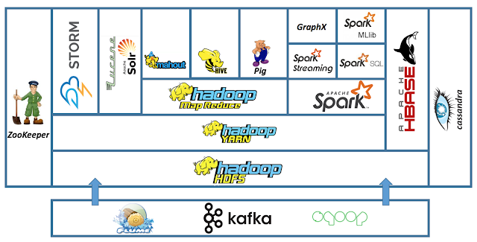
Architecture

Slide 5
Solution Path
Data Transfer to HDFS:
Action: Copy data from local storage to Hadoop Distributed File System (HDFS).
Purpose: To manage and access data efficiently within the Hadoop ecosystem.
Initial Query Execution:
Action: Run basic queries on the data in Hive to evaluate initial runtime.
Purpose: To establish a baseline for query performance.
Data Segmentation into Fact and Dimension Tables:
Action: Divide data into Fact and Dimension tables.
Purpose: To streamline data structure and reduce query runtime.
Performance Evaluation Post-Segmentation:
Action: Execute queries on segmented data to assess performance improvements.
Optimization via Partitioning and Bucketing:
Action: Create new tables based on partitioning and bucketing strategies.
Purpose: To further reduce query runtime by optimizing data access.
Comparative Analysis with SparkSQL and Impala:
Action: Execute the same queries in SparkSQL and Impala.
Purpose: To determine the best SQL engine for query execution based on runtime comparison.

Slide 6
Why solution path Work
Structured Approach: Each step builds upon the previous one, ensuring systematic progress towards optimizing query performance.
Performance Measurement: Regular assessment of query runtime after each step provides clear metrics for improvement.
Comparison of SQL Engines: Evaluates multiple platforms to identify the most efficient solution.

Slide 7
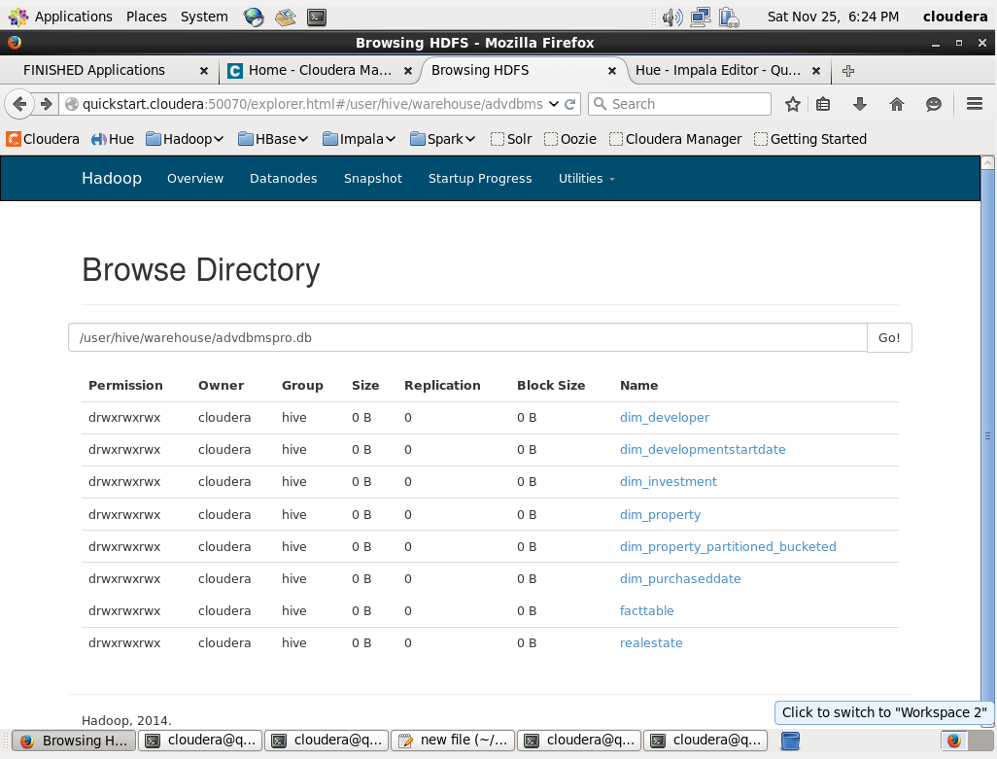
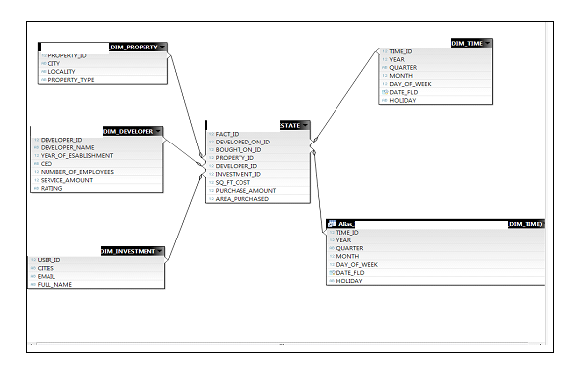
Solution Overview
Fact table: Facts are measurable events related to functional areas of data.
Ex: Sq_ft_cost, area_purchased
Dimension tables: Dimensions are collections of reference information about facts of data. These categorize and describe facts Ex: Property details, Investment details

Slide 8
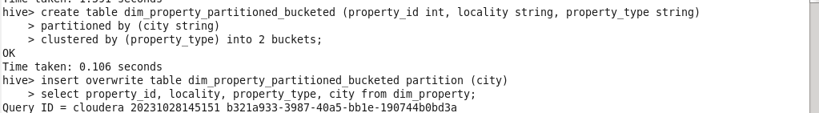
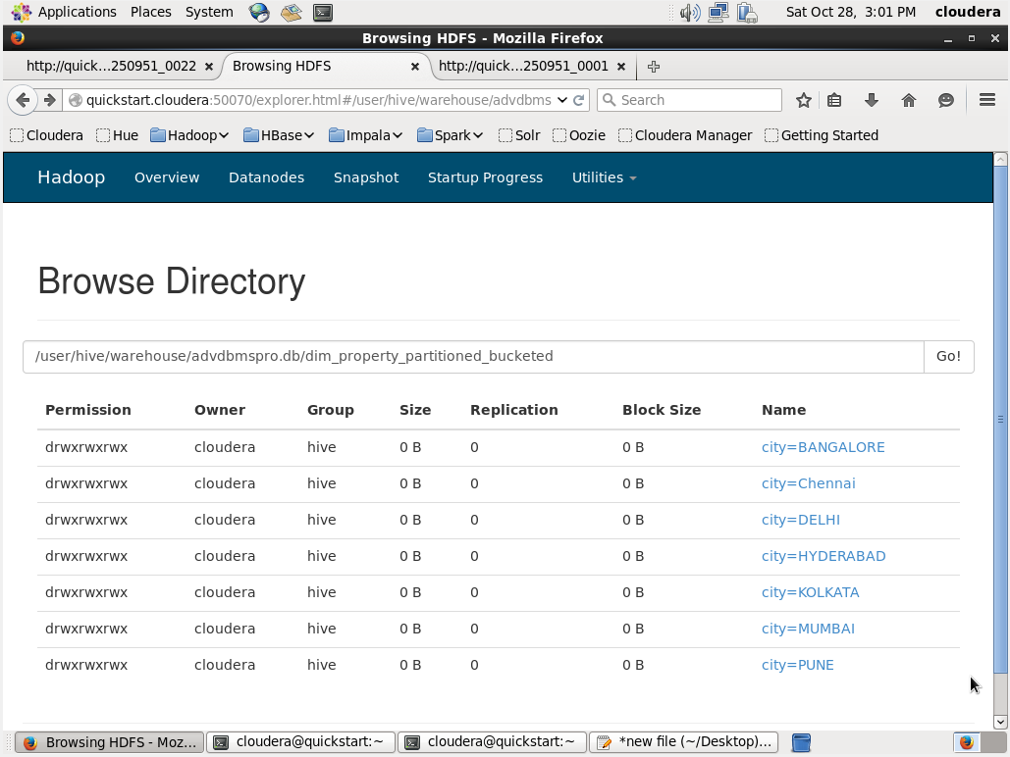
Solution Overview
Partitioning:
Purpose: Improves query performance by dividing a table into parts based on column values.
Bucketing:
Purpose: Further organizes data within each partition or table by dividing it into fixed-size buckets based on a hash function of a column.

Slide 9
Results

Slide 10
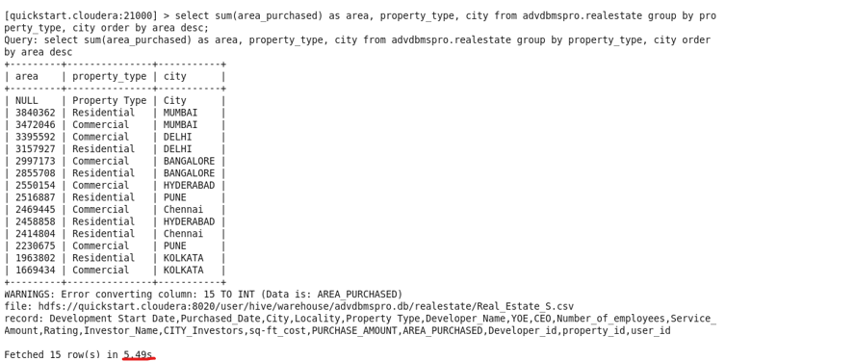
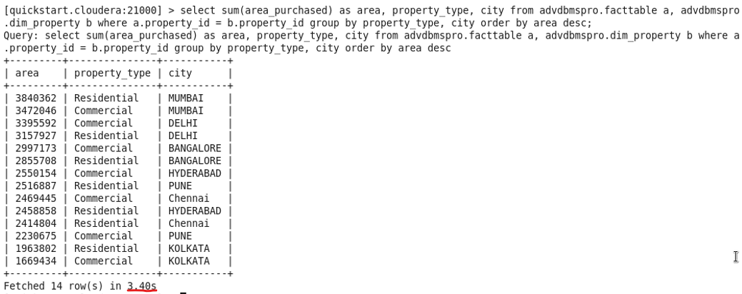
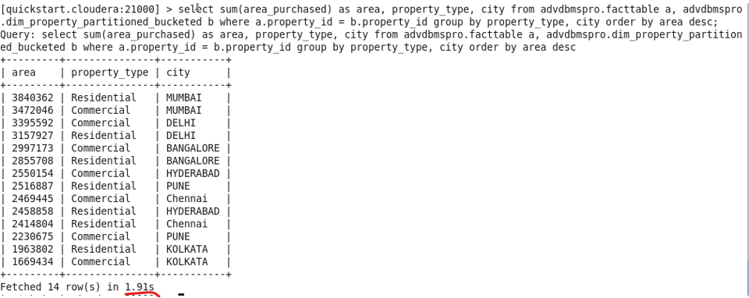
Results
Impala result on basic query without any optimization
Impala result after creating fact and dimension tables
Impala result after creating Partition tables with Bucketing

Slide 11
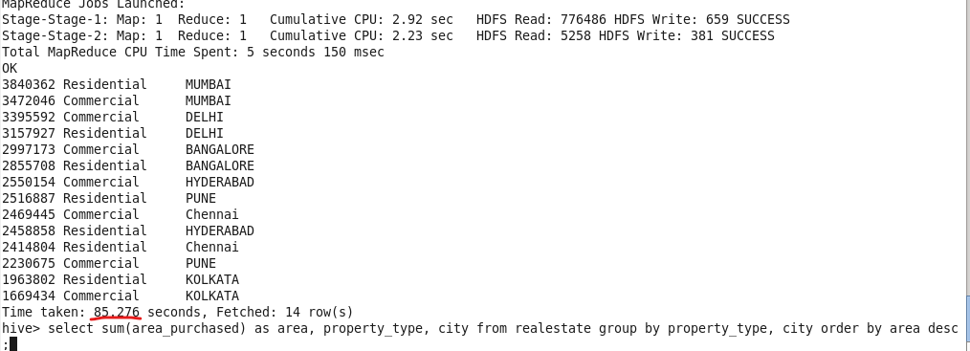
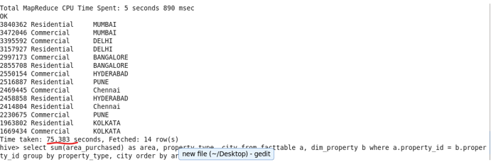
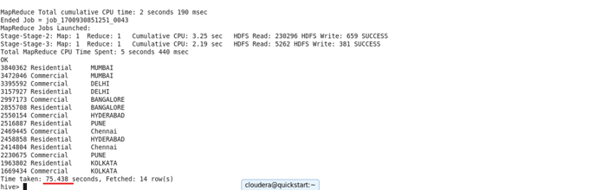
Results
Hive result on basic query without any optimization
Hive result after creating fact and dimension tables
Hive result after creating Partition tables with Bucketing

Slide 12
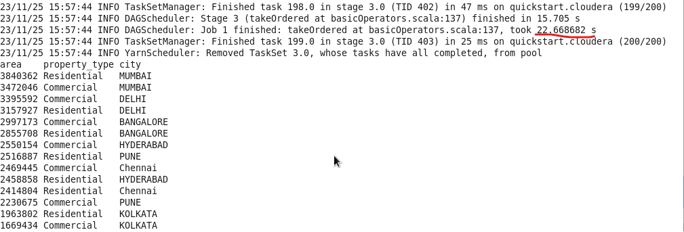
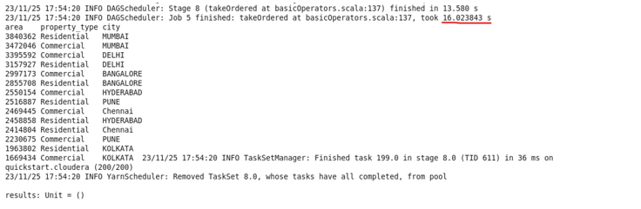
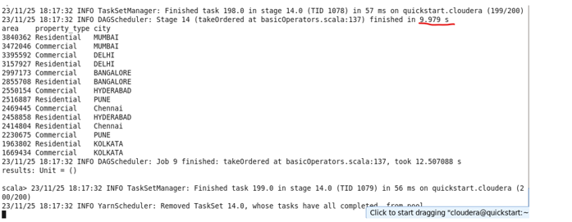
Results
SparkQL result on basic query without any optimization
SparkQL result after creating fact and dimension tables
SparkQL result after creating Partition tables with Bucketing

Slide 13
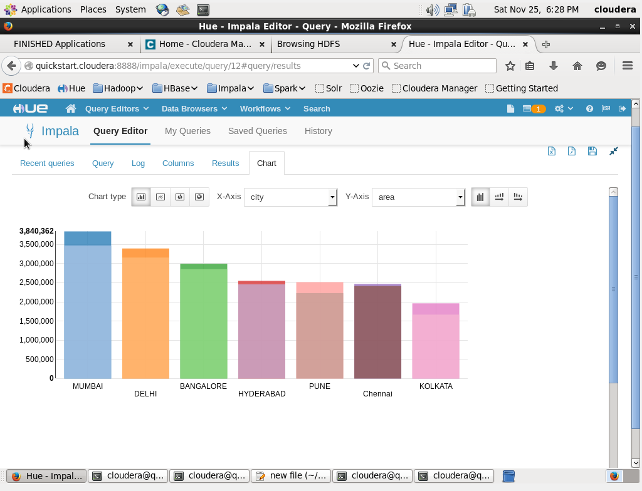
Results

Slide 14
Missing Components
I am currently utilizing Spark 1.3, which is integrated with Cloudera Manager. This integration restricts access to many of the features available in the newer versions of Spark like building spark sessions and advanced Dataframes which can also save query results to HDFS. Due to resource limitations, I am unable to upgrade to the latest version of Spark.
Due to limited time, I'm unable to explore the process of data backup to other database using Sqoop.
I considered experimenting with MapReduce, but given its extensive learning curve and my current time and resource limitations, I haven't been able to thoroughly explore the functionalities of MapReduce.

Slide 15
Conclusion
SparkQL:
SQL-like interface for large datasets.
In-memory processing for performance.
Versatile beyond SQL like use of RDDs and Dataframe operations.
Hive:
Great for structuring data and SQL.
Integrates seamlessly with Hadoop.
Uses MapReduce, may be slower for some queries.
Impala:
Fast, low-latency SQL queries.
In-memory and columnar processing.
Direct data access for efficiency.
SparkQL & Hive: Large datasets and Structuring data.
Impala: Quick queries on medium-sized data.

